Slide 1
Comparison of Risk-Adjusted Returns: Long-Term Bonds vs Dividend Stocks
Sully Dawood

Slide 2
Agenda
Topic
Methodology
Data
Results
Conclusion

Slide 3
Long-Term Bonds vs Dividend Stocks

Slide 4


Target Investor Group
Single Parents
Provide additional income to cover child’s expense
Secure future
Retired Citizens
Safety of corpus
Steady increasing income

Slide 5
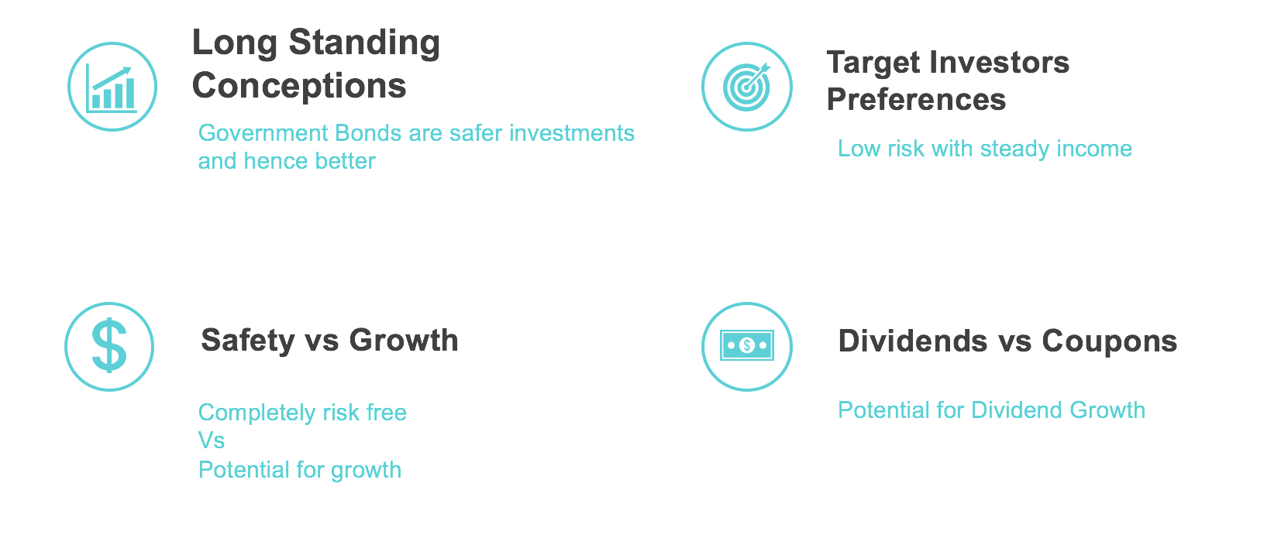
Motivation for Comparison
Comparing Long Term Bonds to Dividend Stocks
Long Standing Conception
Government Bonds are a safer investment
Safety vs Growth
Low Risk vs Potential Growth
Target Investor Preferences
Low risk with steady income
Dividends vs Coupons
Potential for Dividend Growth

Slide 6
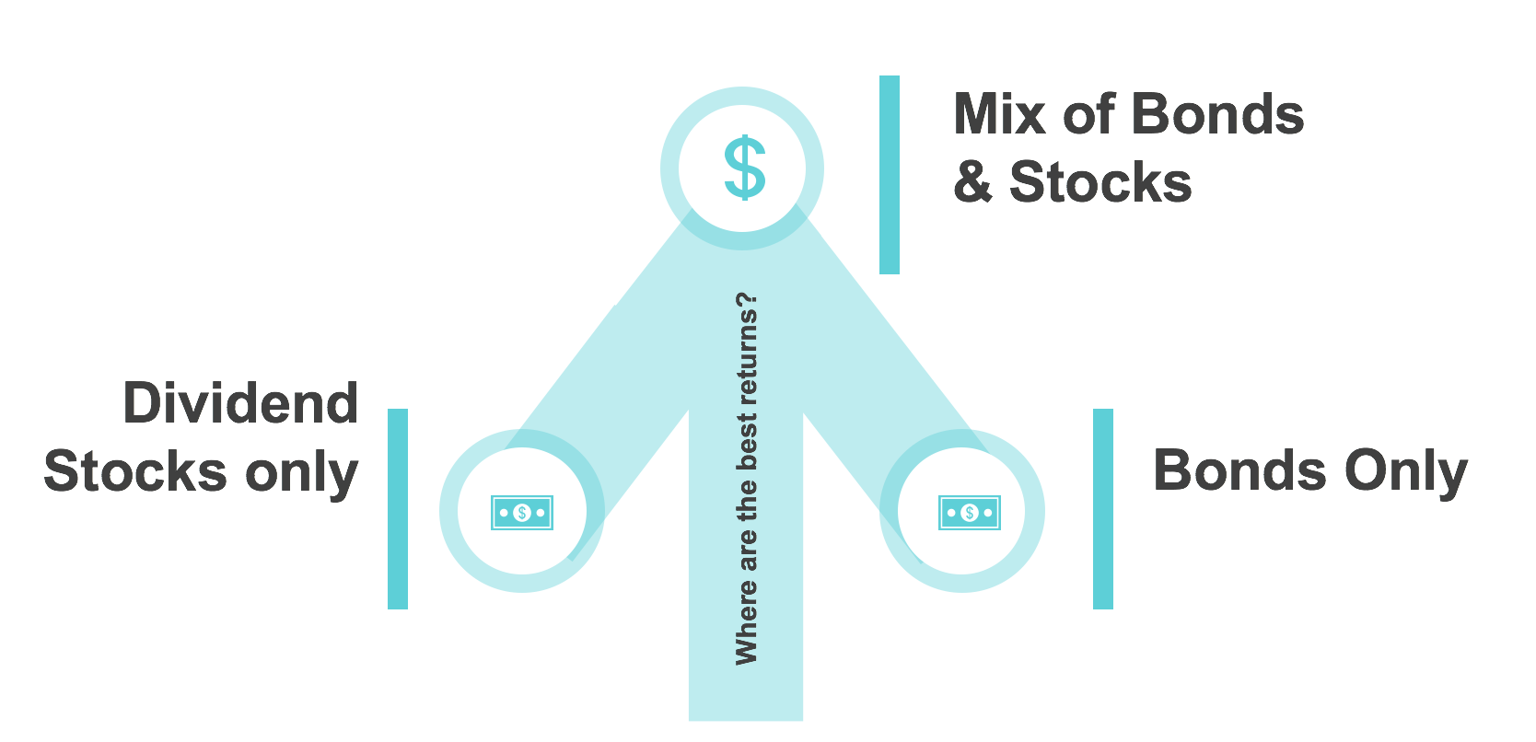
Possible Optimal Outcomes
Mix of Stocks and Bonds
LT Bonds only

Slide 7
Methodology

Slide 8
Methodology
Performance Measures
Annualized Returns/Volatility
Sharpe Ratio
Certainty Equivalence Return
To construct our optimal portfolio, we consider:
Solver for optimal weights and portfolio allocation
Efficient frontier & CML with ETF bonds and Dividend Stocks
Notes:
Monthly Data to calculate annualized returns and volatility
Sharpe ratio to determine risk adjusted return for each
CER: investor to give up a certain return or zero risk return for a larger return with an associated risk to it
This will depend on the investor’s risk tolerance so we’ll also look at investors with varying levels of risk aversion coefficients to determine that.

Slide 9
Data

Slide 10
Data Sources
Sampling Period: July 2002 - October 2018
U.S. 1-Month Treasury Bill as Risk-Free Rate
iShares 20+ Year Treasury Bond ETF
Portfolio of Dividend Stocks based on Dividend Yield

Slide 11
iShares 20+ Year Treasury Bond ETF
Inception July 2002
Exposure to Long-term Treasury Bonds
Tracks the investment results of an index composed of U.S. Treasury bonds with remaining maturities greater than 20 years.
Notes:
WHY LLT?
1. Exposure to long-term U.S. Treasury bonds
2. Targeted access to a specific segment of the U.S. Treasury market
3. Use to customize your exposure to Treasuries

Slide 12
Portfolio of Dividend Stocks
All NYSE, AMEX, and NASDAQ stocks
Portfolios are formed on D/P at the end of each June using NYSE breakpoints. The dividend yield used to form portfolios in June of year t is the total dividends paid from July of t-1 to June of t per dollar of equity in June of t.
Portfolio consists of Middle 40% in terms of Dividend Yield
Notes:
Portfolios are formed on D/P at the end of each June using NYSE breakpoints. The dividend yield use to form portfolios in June of year t is the total dividends paid from July of t-1 to June of t per dollar of equity in June of t.
All NYSE, AMEX, and NASDAQ stocks for which we have ME for June of year t, and at least 7 monthly returns (to compute the dividend yield) from July of t-1 to June of t.

Slide 13
Results

Slide 14
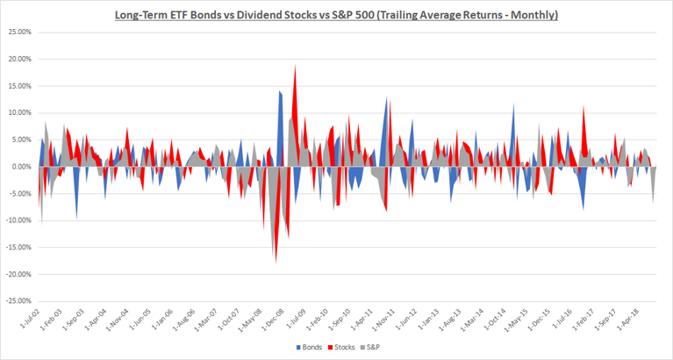
Trailing Returns Comparison: LT Bonds vs Div Stocks
Notes:
- Long-term Bonds and Dividend Stocks seem to have a negative relationship, which will quantify in the next slide. ​
- S&P 500 comparison ---> show kind of what was happening in the world at the time. ​
- S&P performs poorly in the Stock Market downturn of 2002 + Financial Crisis of 2008.​
-

Slide 15
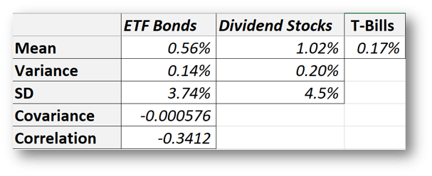

Historical Mean and Volatility
Weak Covariance
Negative Correlation
Notes:
- Weak Covariance between LT Bonds and Dividend Stocks​
- Negative Correlation between the two​
- Individually, Dividend Stocks have a higher Sharpe Ratio

Slide 16
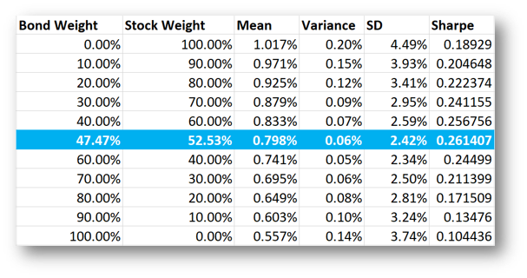
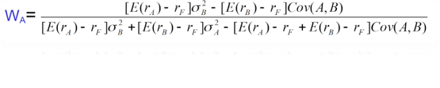
Optimal Portfolio Weights
Notes:
- Using the data from the previous slide, we calculate the ideal weights for the optimal portfolio to maximize our Sharpe Ratio​
- Optimum weights were 47% in Bonds and 53% in Stocks ​
- As you can see, these weights give us the best Sharpe Ratio

Slide 17
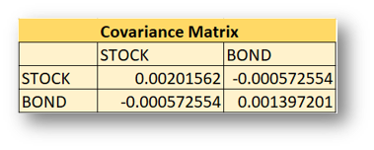
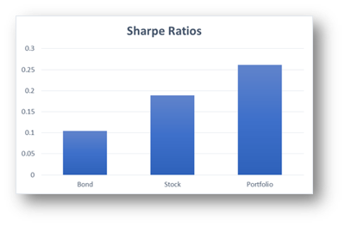
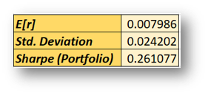
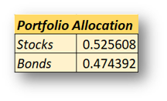
Optimal Portfolio Verification
Notes:
We confirm our manual calculations by creating a covariance matrix in excel and using the solver tool. - comforting that we got the same stuff​
We see that the optimal portfolio, on the basis of sharpe ratios, outperforms both a portfolio of just stocks and just bonds​
we conclude that diversification has a large impact on our sharpe ratio

Slide 18
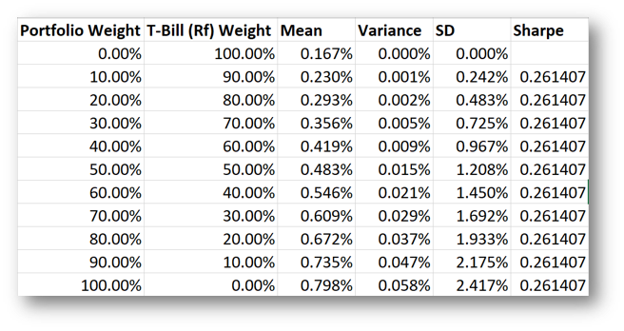
Incorporating 2-asset Optimal Portfolio W/A Risk-Free Asset
All portfolios have an optimal weight of 53% in stocks and 47% in bonds
Same Sharpe Ratio for different Weight Combinations. This is slope of CML

Slide 19
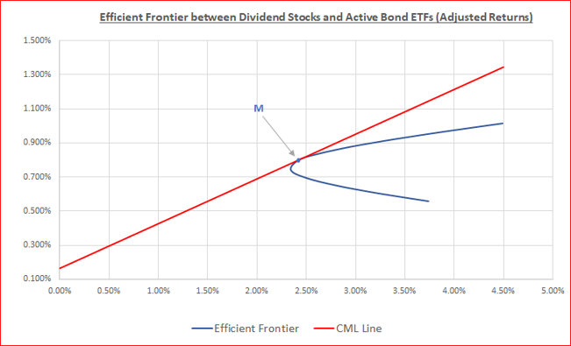
Efficient Frontier and Capital Market Line
CML incorporates our risk-free asset into our Optimal Portfolio
“M” represents feasible region between our risky assets (Stocks + ETF Bonds)
Using the CML, the investor can maximize return for any given level of risk/risk aversion.
Notes:
- This graph shows the Efficient Frontier between our Dividend Stocks and LT Bonds​
- It also shows the Capital Market Line, which incorporates risk-free T-bills into our Optimal Portfolio​
- The "M" marked on the graph above represents the feasible region for our risky assets (Stocks + ETF Bonds). ​
- Also, "M" is the point where the rational investor would hold the basket of our risky assets in the same proportion as a theoretically efficient market portfolio.​
- Furthermore, the CML Line shows us how an investor can maximize return for any given level of risk aversion

Slide 20
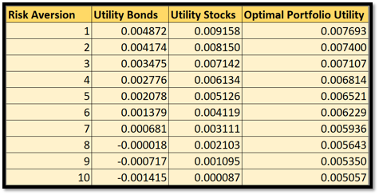

Optimal Utility with Varying Risk Aversion
Bond utility function drops below .17% at a risk aversion of 6
Dividend Stock Utility function drops below .17% at a risk aversion of 9
The optimal portfolio utility never drops below .17%
Below Historical Mean Risk Free Rate
Notes:
The certainty equivalent is a guaranteed return that someone would accept rather than taking a chance on a higher, but uncertain, return.

Slide 21
Conclusion

Slide 22
Summary
We find evidence that investing in Dividend Stocks > investing in Long-Term Bonds​
However, holding an optimal portfolio of the two gives us a greater Sharpe Ratio or a better “reward-to-risk”.
Including a risk-free asset into the portfolio of Stocks and Bonds aids in creating a portfolio where investors can choose their preferred position on the Capital Market​ Line according to their degree of risk aversion.​
Furthermore, we find that even with high levels of risk aversion, our optimal​
portfolio gives investors a better Utility than solely investing in the risk-free rate.​
​
In Conclusion, holding our Optimal Portfolio surpasses any individual investment - be it in​
Dividend Stocks, Long-term Bonds, or the Risk-Free rate – with any level of​
Risk-aversion over the period July 2002 to October 2018
Notes:
- Investing in dividend stocks alone is a more attractive option than investing in long term bonds alone. ​

Slide 23
Considerations
Use Other Metrics:
Jensen’s Alpha
Treynor Measure
Use Rolling Returns
Data Limitations
Notes:
Treynor was the first to provide investors with a composite measure of portfolio performance that also included risk.
a recent performance bias
The impact of highly favourable or unfavourable events or market situations also becomes visible in measuring rolling returns. So gives us a more unbiased result.

Slide 24

Thank you!
Questions?

